Slide 1

Internet Banking System

Slide 2
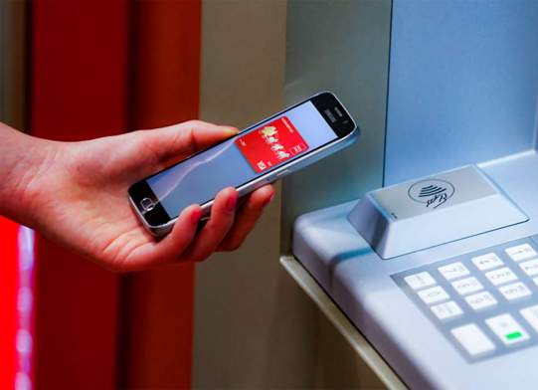
MOTIVATION
I decided to create this Internet Banking System for people that want to get rid of their physical cards and do everything with their phone.
This app allows you to send/ request money from other users and deposit/ withdraw money (with nothing but your phone) if you are at an ATM.

Slide 3
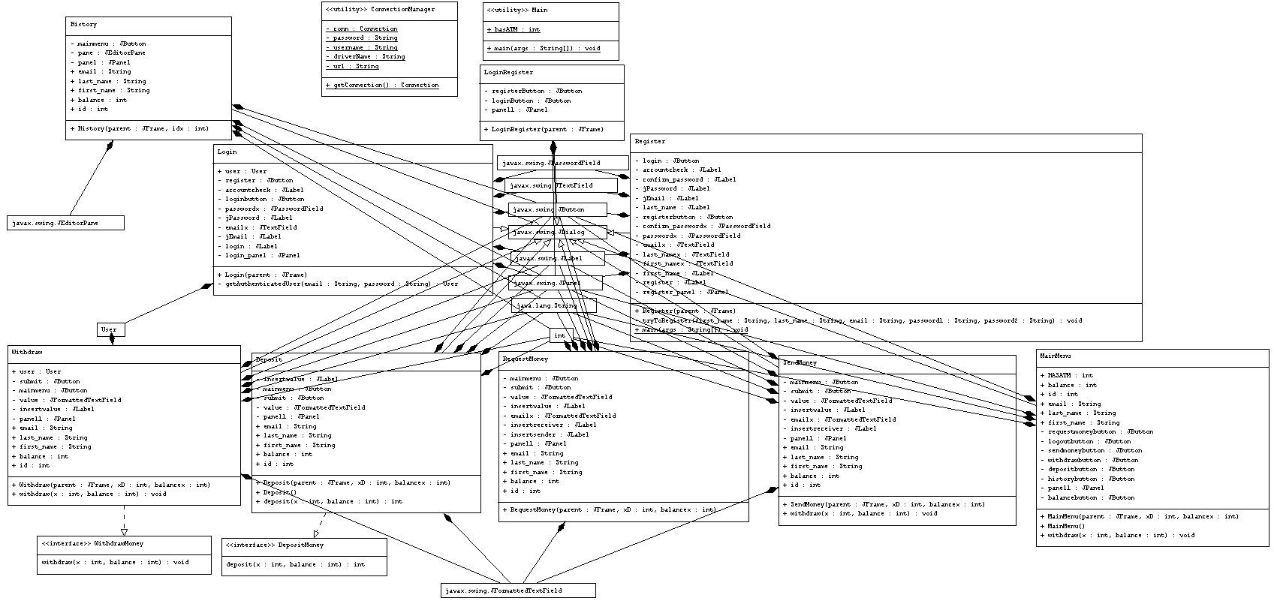
This is the diagram containing the classes and interfaces used in this project. Creating the diagram was not as straight forward as I thought it would be, but I managed to get it done in the end.

Slide 4
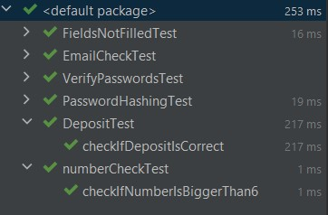
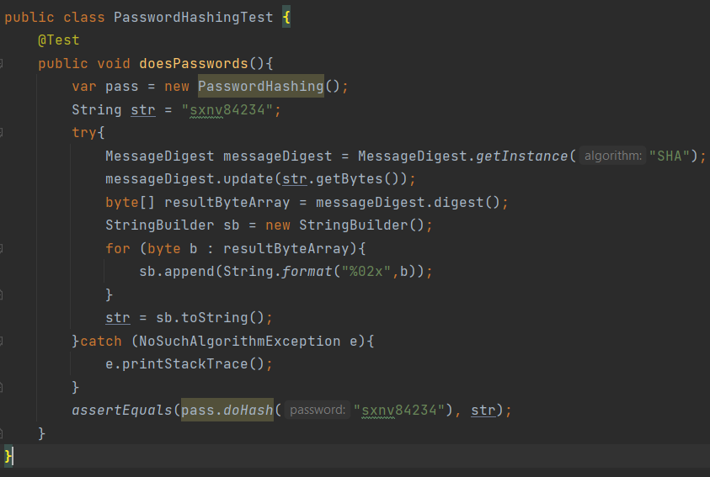
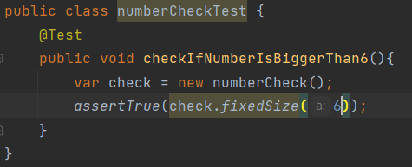
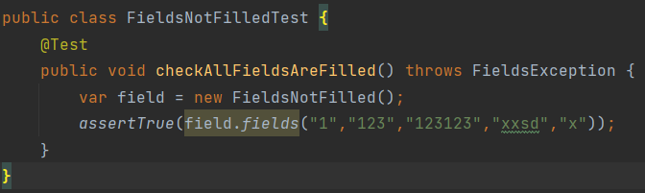
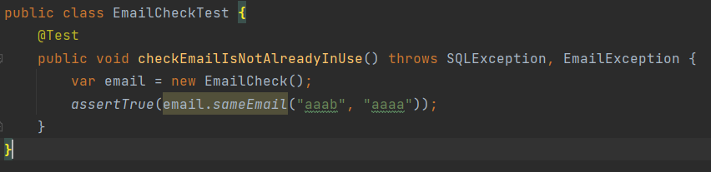
Creating the unit tests was easier than I expected, I thought it would be more of a challenge but it turned out to be the easiest part of the project.

Slide 5
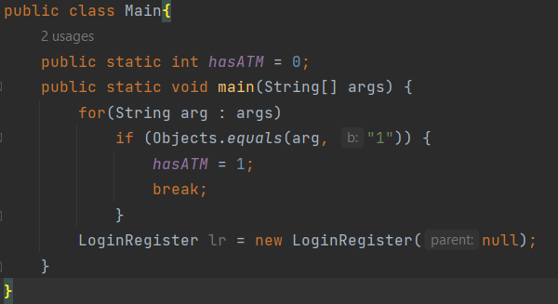
The project uses program arguments to determine if the user is at an ATM or not. If the user is at an ATM he is allowed to deposit/ withdraw money, otherwise it is impossible for him to do that

Slide 6
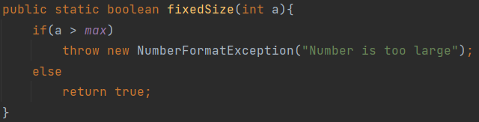
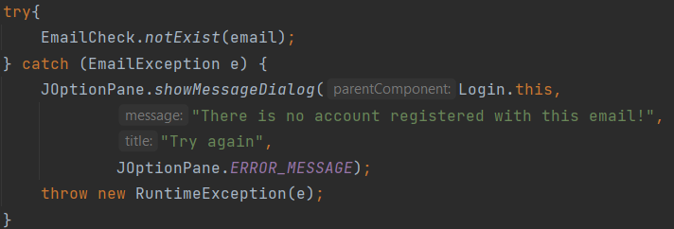
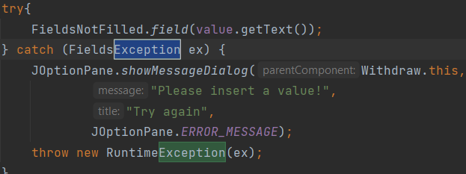
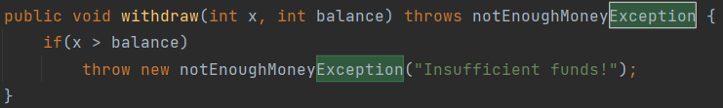
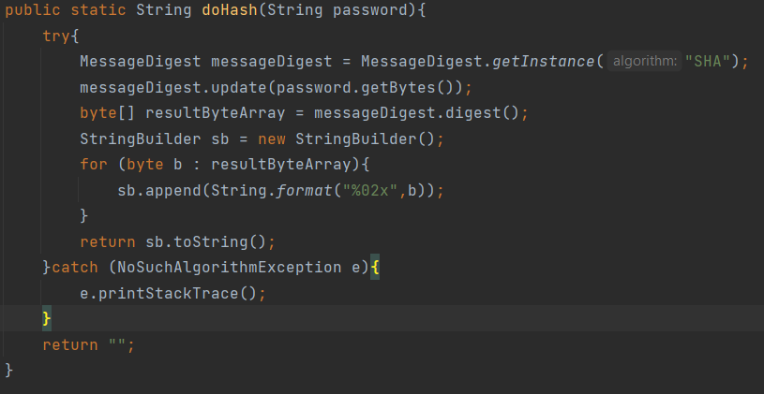
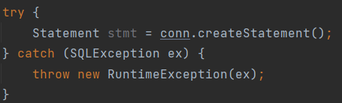
Identifying exceptions and creating custom ones was a vital part of the project, without them the project wouldn’t work at all.
It wasn’t the easiest task but I wouldn’t say it was the hardest either; most exceptions just made sense to use/ create.

Slide 7
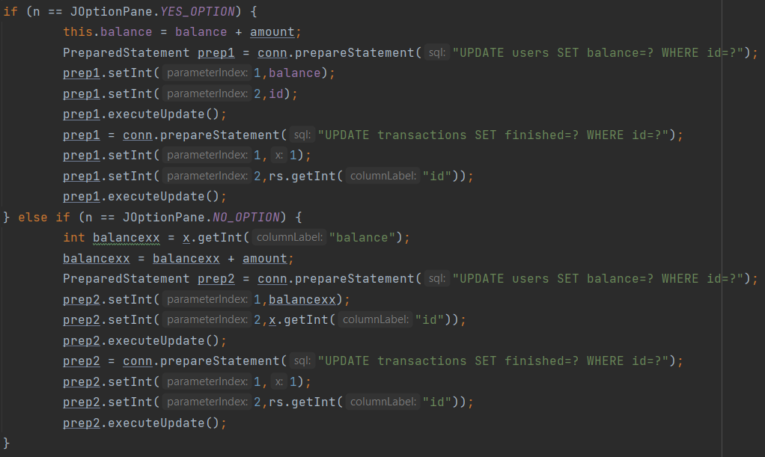
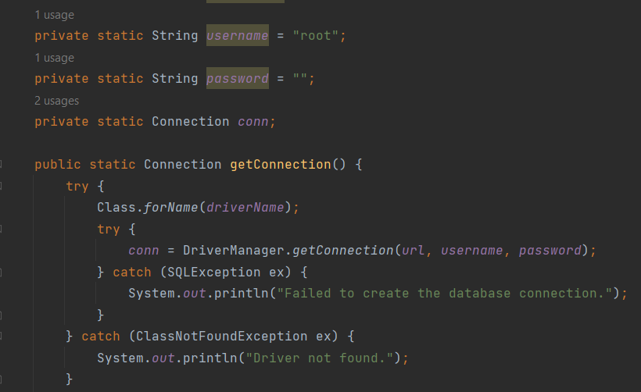
Creating the database connection was vital in order to have a working project. The database holds all the users’ information and every transaction. Upon pressing on the history button on the app, the user can see all his transactions.
Everything gets updated as soon as it is changed, no information is lost.

Slide 8
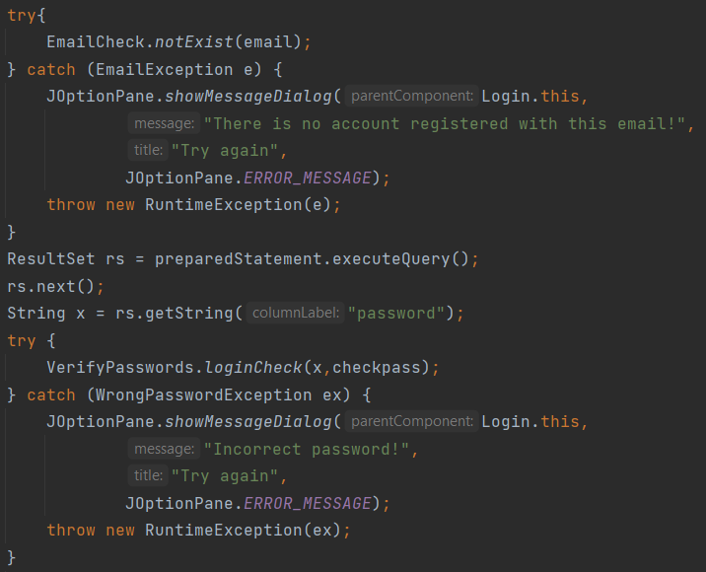
The app would be a mess without input validation; input validation is in place for every input.
If the input requires an email it checks if the string entered is indeed an email, it checks if the passwords match upon creating a new user, it makes sure that the user exists, that the amount to be withdrawn/ deposited is not too big or that you have enough funds.

Slide 9
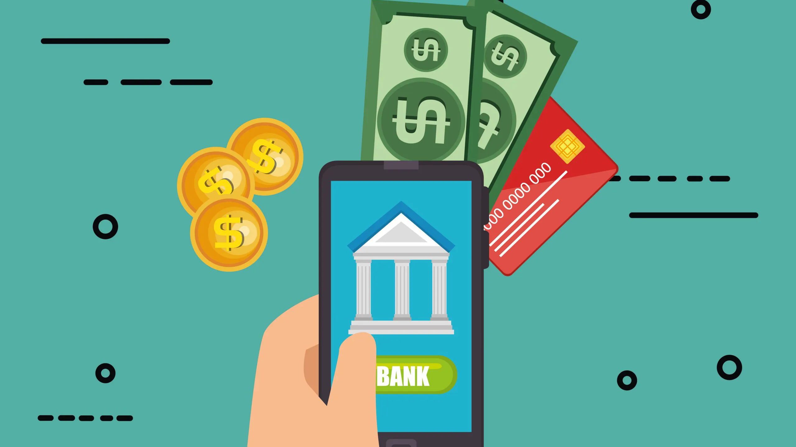
Thank you
Eduard Soreata

